Slide 1


Fintech Related Machine Learning: Experimental Investigation on the Effects of Data Variance Towards Difficulty of Learning for Deep Learning Models
Prepared By: Shearman Chua
FYP Supervisor: Dr Althea Liang

Slide 2





Introduction
Methodology
01
02
Results
Conclusion
03
04
Introduction
Project Background and Review of Past Research
Project Objectives and Experimental Setup
Results and Observations Obtained from Experiments
Project Conclusion and Future Work

Slide 3

01
Introduction

Slide 4





Background
Algorithmic Trading
Financial Risk Assessment
Deep Learning
Financial Text Classification
Cryptocurrency
Notes:
The application of Artificial Intelligence models in the domain of Financial technology, or more commonly known as Fintech, has been widely studied throughout the years. With the use of Deep Neural Networks, or Deep Learning models, for Fintech applications becoming more prevalent in recent years. Deep Learning models have been used for Fintech applications such as Algorithmic Trading, Financial Risk Assessment, Financial Text Classification as well as Cryptocurrency and blockchain studies. For our Final Year Project, we will be focusing on the application of Deep Learning models for Stock Prediction tasks.

Slide 5
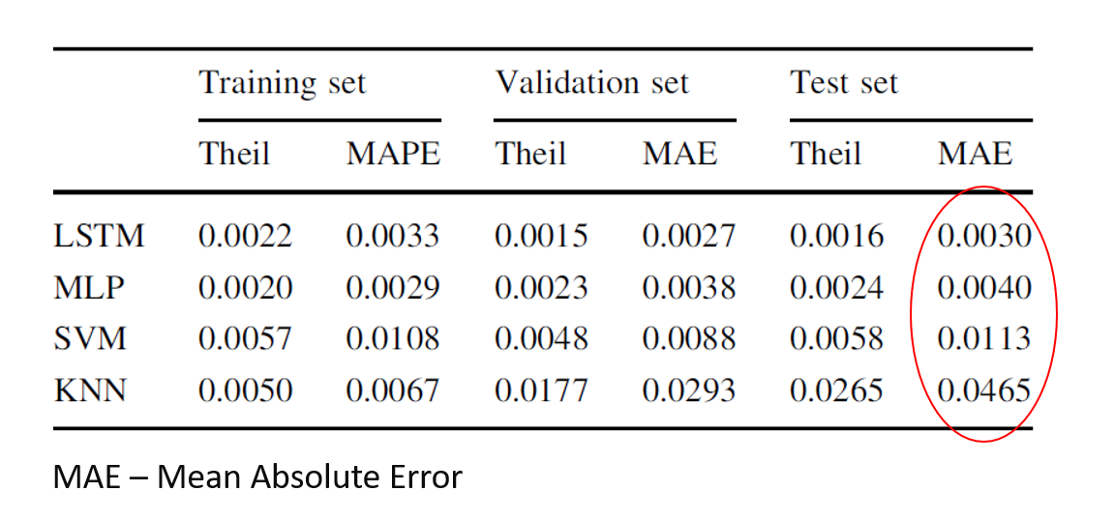
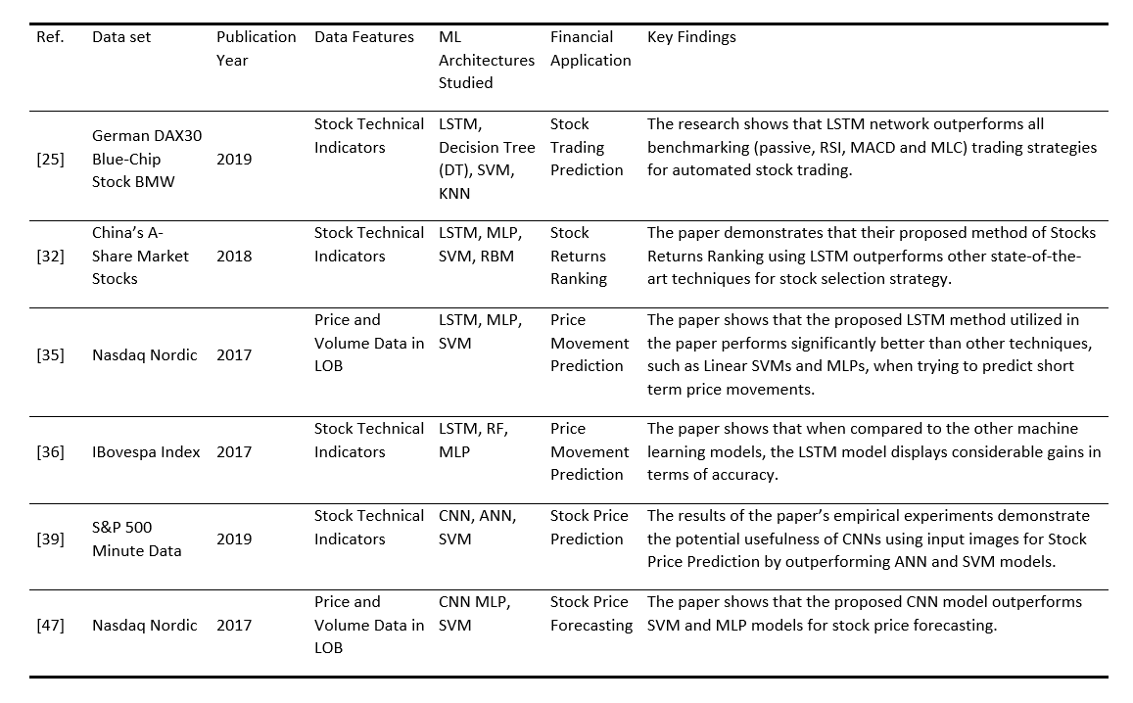
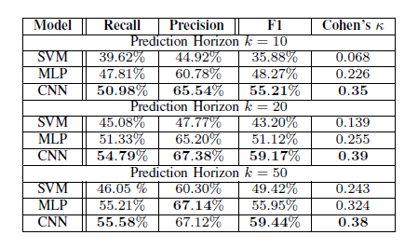
Literature Review
LSTM
Deep Learning
H. Yan and H. Ouyang, "Financial Time Series Prediction Based on Deep Learning," Wireless Personal Communications, vol. 102, no. 2, pp. 683-700, 2018/09/01 2018, doi: 10.1007/s11277-017-5086-2.
01
Stock Market Related Applications
CNN
A. Tsantekidis, N. Passalis, A. Tefas, J. Kanniainen, M. Gabbouj, and A. Iosifidis, "Forecasting stock prices from the limit order book using convolutional neural networks," in 2017 IEEE 19th Conference on Business Informatics (CBI), 2017, vol. 1: IEEE, pp. 7-12.
Notes:
In past research conducted on the use of Deep Learning models for Stock Market related Fintech applications (click), Long Short-Term Memory (LSTM) Recurrent Neural Network, and Convolutional Neural Network are the most commonly used Deep Learning models for Stock Market applications such as prediction of next-day stock prices, stock portfolio management, trading signal predictions etc.
And past research provided evidence(click) that LSTM and CNN models perform better than traditional shallow ML models such as Support Vector Machines and shallow Multilayer Perceptrons for stock market prediction tasks in terms of prediction Error for regression tasks and F1 score for classification tasks

Slide 6

Literature Review
LSTM
02
For Stock Market Related Applications
Regression Tasks
Capable Of Learning Order Dependence In Sequence Prediction Problems
Solves Vanishing Gradient Problem
Used In Financial Applications Research Involving Sequential Data
Proven To Perform Better Than MLP And Traditional RNN Models
Notes:
LSTM models have been used in past research, mainly for regression tasks such as to predict stock prices for the next trading day, usually based on time-series input of stock indicators data from past n number of lookback days.
LSTM models are capable of learning order dependence in sequence prediction problems and were developed to deal with the vanishing gradient problem that can be encountered when training traditional RNNs which makes them well-suited for classifying, processing, and making predictions based on time-series or sequential data.
Therefore, they are often used in Financial applications research involving sequential data such as stock market prediction tasks utilizing stock technical indicators time-series data and have been proven to perform better than MLP and traditional RNN models for these tasks

Slide 7
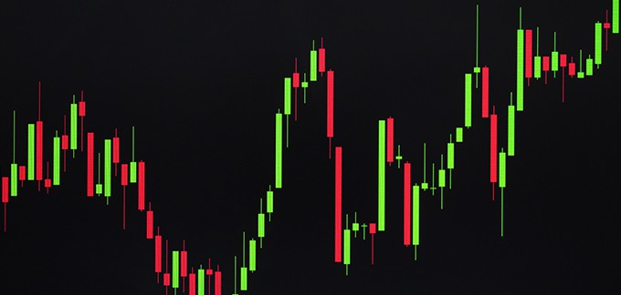
Literature Review
CNN
03
For Stock Market Related Applications
Classification Tasks
Able To Capture Spatial And Temporal Dependencies
Convert Sequential Stock Technical Indicators Time-series Data Into Graph Plots Images
Performance Better Than Traditional Shallow Machine Learning Models
Notes:
While LSTM models are more commonly used for stock market prediction tasks due to the sequential nature of the input data, CNN models have also been used in past research for stock market prediction tasks mainly involving classification. One of such task is the prediction of stock trading signals such as “buy”, “hold” or “sell”
As CNN models are most commonly applied to analyzing visual imagery due to their ability to capture the Spatial and Temporal dependencies in an image, past research often convert (click) the sequential stock technical indicators time-series data into images of technical indicators graph plots as training data for stock market prediction
Similar to LSTM models, past research proved that the performance of CNN models for stock market prediction tasks are better than that of traditional shallow Machine Learning models, with performance comparable to that of LSTM models

Slide 8
Literature Review
Training Data Used
04
For Stock Market Related Applications
Different Research Make Use Of Different Datasets
Input Features Vary From One Research To Another
Unable To Determine If Models Performance Will Be Affected Using Different Datasets Or Input Features
Notes:
From the survey of past research conducted on the used of Deep Learning models for Stock Market Prediction tasks, we realized that different research make use of different datasets to conduct their experiments
In addition, the stock technical indicators used as input features also vary from one research to another. Therefore, we are unable to compare the results of one research to another and we are not certain if the performance of the models will be affected using different datasets or input features.

Slide 9
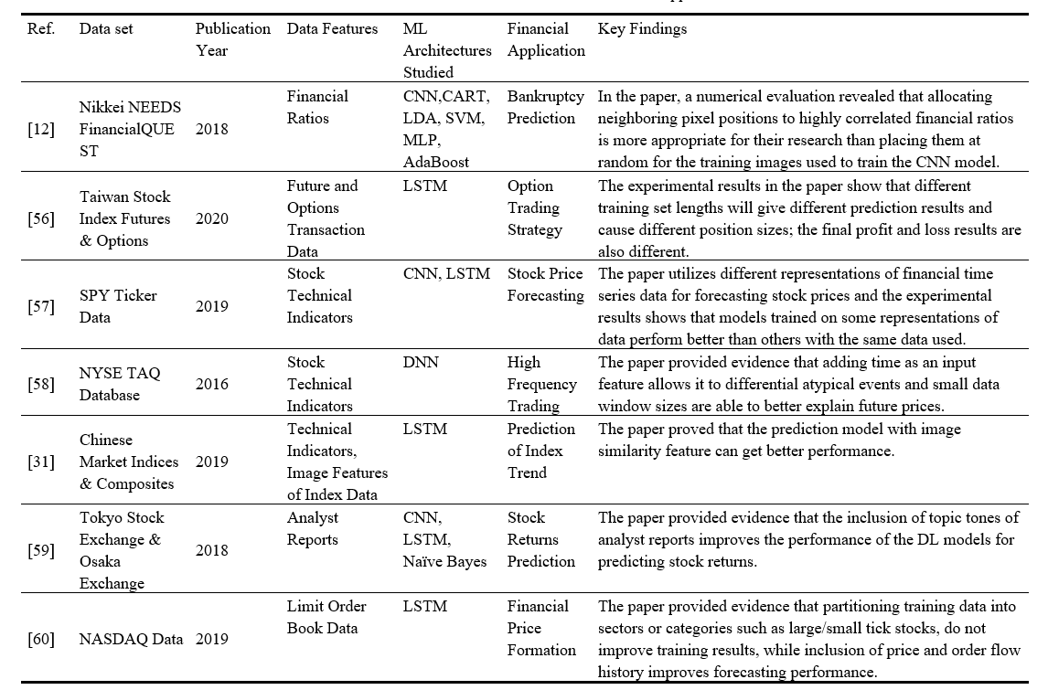
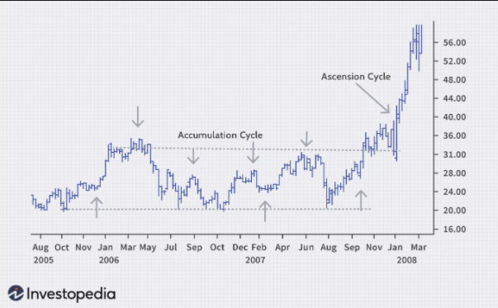
Literature Review
05
Effects of Data Variance
Minimal Work Done On Effects Of Variations In Training Data On Models For Learning Stock Market Prediction
Characteristics Of Training Samples Affect The Ability Of Models To Learn The Tasks They Are Given
Data Variance Affects The Performance Of Deep Learning For Financial Applications
Notes:
Furthermore, minimal work has been done to study the effects of variations present in the training data on the ability of the models to learn the task of Stock Market Prediction
Past research regarding the use of Deep Learning for other applications have shown that the characteristics of the training samples in the dataset used to train Deep Learning models affect the ability of the models to learn the tasks they are given. In the paper by Liang et al, results suggests that variances of visual objects in images affects the amount of learning or information gained by the Deep Learning models significantly.
And there are past research conducted using Deep Learning models for financial applications which showed that data variance or data representation affects the performance of Deep Learning models.

Slide 10
02
Project Methodology

Slide 11

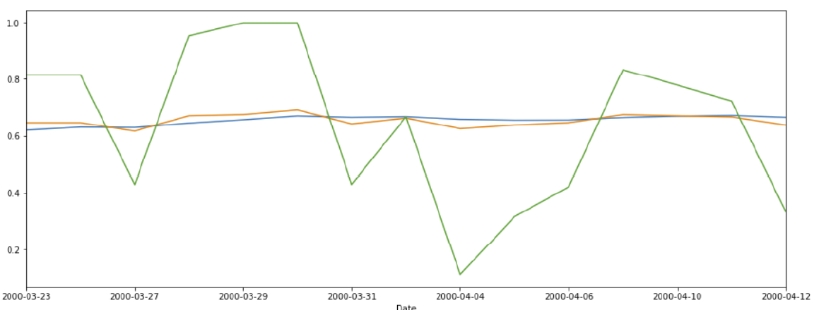
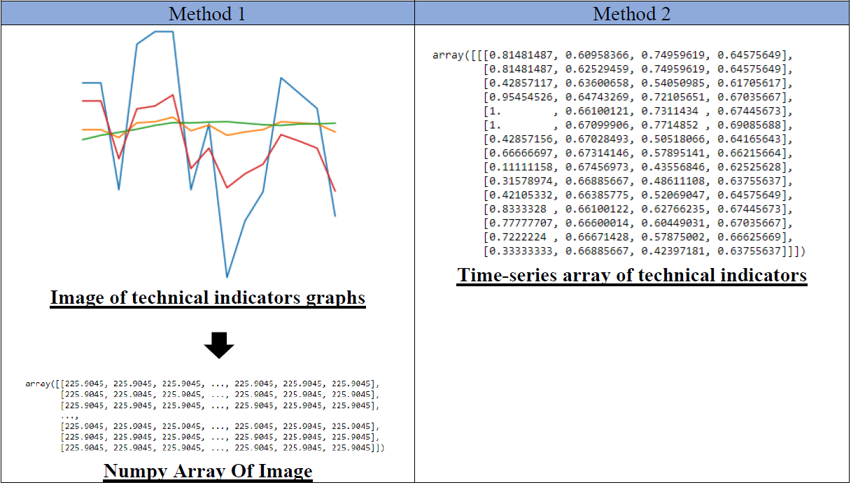
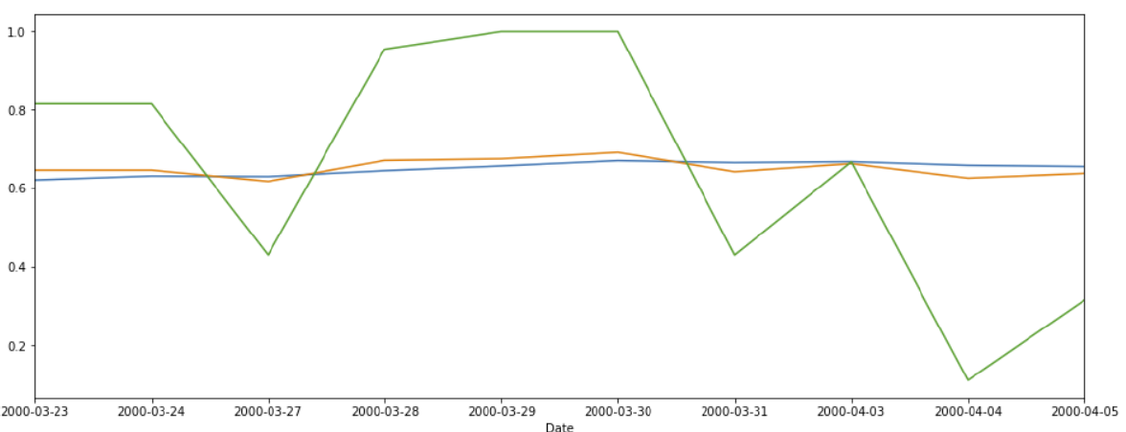
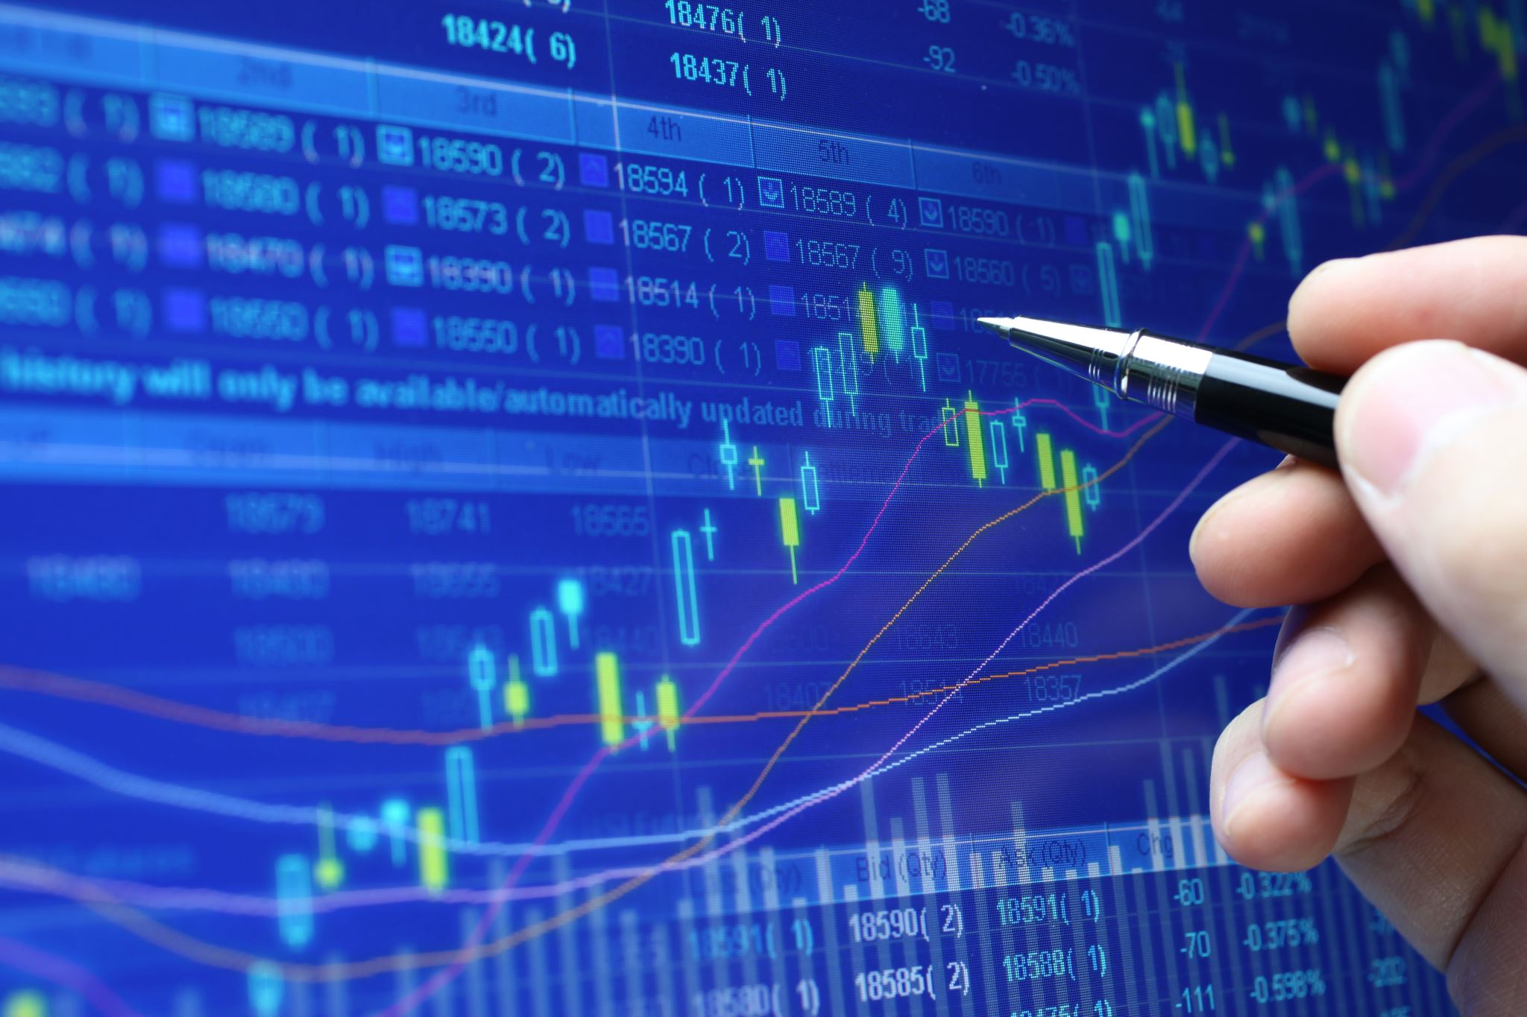


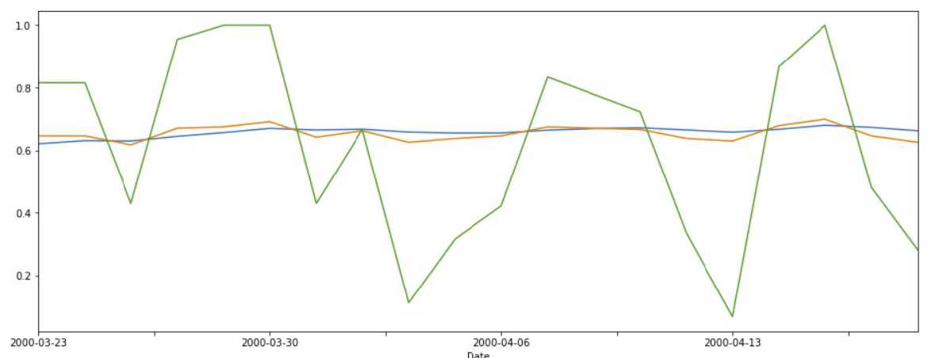
STUDY OBJECTIVES
Variation 1
Variation 18
Date | Close | SMA | … | WILLR
02/01/20 | 30.1 | 29.9 |  | 2.1
03/01/20 | 30.2 | 30.0 |  | 2.3
06/01/20 | 30.0 | 30.1 |  | 1.5
07/01/20 | 31.1 | 31.2 |  | 2.9
Date | Close | SMA | … | WILLR
02/01/20 | 30.1 | 29.9 |  | 0
03/01/20 | 30.2 | 30.0 |  | 0
06/01/20 | 30.0 | 30.1 |  | 0
07/01/20 | 31.1 | 31.2 |  | 0
Does variations in training data affect learning of models?
…….
Input Data Format?
Introduction of different variations to Training Data
Lookback Period Duration?
Experimental Investigation
Take into consideration stock market specific factors
Does the type of Stock Cycle Phase data is collected from affects training?
Notes:
Therefore, from the review of past research conducted on the use of Deep Learning models for Stock Market related applications we discovered that there is a need to study the effects of variations present in the training data on the ability of the Deep Learning models to learn the task of Stock Market Prediction, specifically stock trading action prediction.
The objective of our Final Year Project, is to conduct an Experimental Investigation(click) on the effects of introducing different variations(click) to the training data used to train Deep Learning models, on the ability of these models to learn the task of stock trading action prediction. The variations introduced should allow us to better understand how various variations present in the training data affect the ability of Deep Learning models to learn the task of stock trading action prediction. The variations should also take into consideration(click) stock market specific factors likely to affect stock prices and movement.

Slide 12


Experimental Set Up
Models
Deep Learning Models Used for the Experiments
DATA
Data Used to Train the Deep Learning Models
Variations
6 Sets of Variations Introduced to the Training Data

Slide 13
Experimental Set Up
DATA
Data Used to Train the Deep Learning Models
Daily Stock Data obtained from Yahoo Finance
Other Stock Technical Indicators derived using TA-Lib library
WILLR%, Closing Price, EMA, and OBV used as data features
Notes:
For our project, the daily trading Volume, Opening, Closing, High and Low stock prices of various stocks used for the experiments are obtained from Yahoo Finance, and other stock technical indicators are derived using the TA-Lib library in Python.
The 4 technical indicators selected for use are the WILLR(Williams Percent Range) indicator tracking the stock’s momentum, Closing Price indicator tracking the changes in Closing Prices of the stock, EMA(Exponential Moving Average) indicator tracking the moving average of the Stock, and OBV(On-Balance Volume) indicator tracking the volume changes of the Stock.

Slide 14
Experimental Set Up
Models
Deep Learning Models Used for the Experiments
DATA
Data Used to Train the Deep Learning Models
Variations
6 Sets of Variations Introduced to the Training Data

Slide 15
Experimental Set Up
Models
Deep Learning Models Used for the Experiments
Convolutional Neural Network
Long Short-Term Memory Recurrent Neural Network
Notes:
For our Project, our Experimental Investigation was conducted using two types of Deep Learning models , Convolutional Neural Network, as well as Long Short-Term Memory Recurrent Neural Network

Slide 16
Experimental Set Up
Models
Deep Learning Models Used for the Experiments
DATA
Data Used to Train the Deep Learning Models
Variations
6 Sets of Variations Introduced to the Training Data

Slide 17

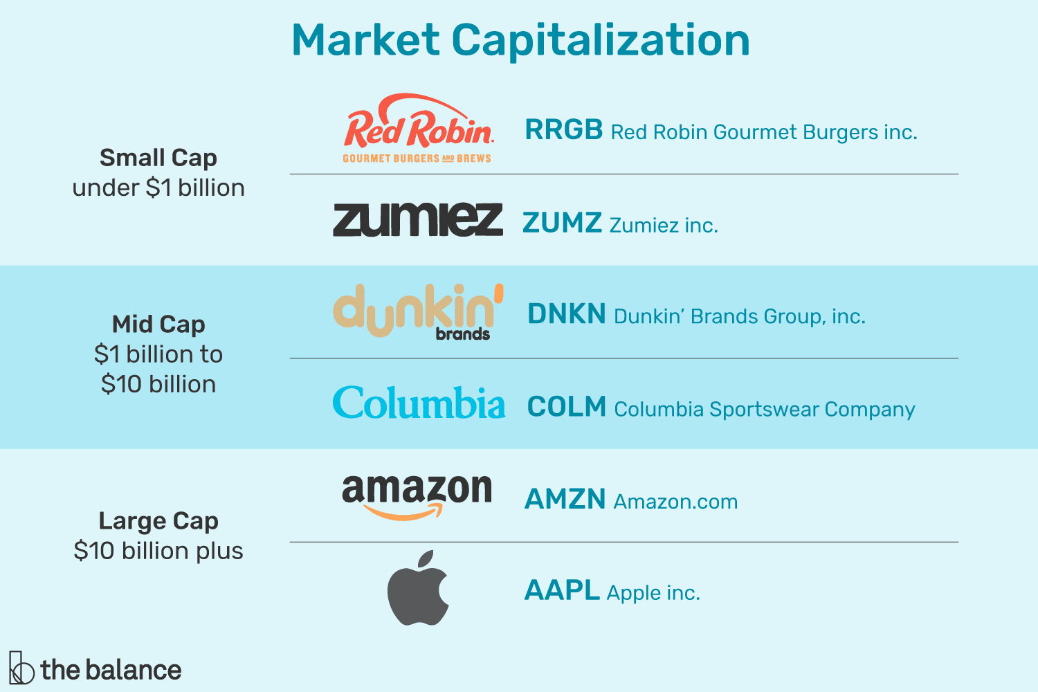
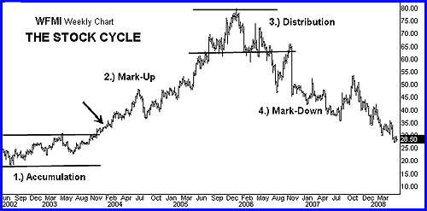
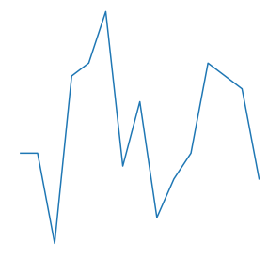
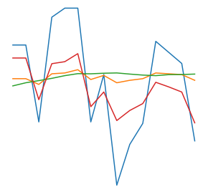

Experimental Set Up
25 percent more “Buy” Class Samples
Variation 2
25 percent more “Hold” Class Samples
Variation 1
Variation 3
25 percent more “Sell” Class Samples
Variations
Variation 2: Lookback period duration
Variation 3: Training Samples Ratio
Variation 1: Presentation of training data
Training Data
Date | Close | SMA | … | WILLR
02/01/20 | 30.1 | 29.9 | ……. | 2.1
03/01/20 | 30.2 | 30.0 | ……. | 2.3
06/01/20 | 30.0 | 30.1 | ……. | 1.5
07/01/20 | 31.1 | 31.2 | ……. | 2.9
6 Sets of Variations Introduced to the Training Data
Variation 4
Variation 5
Variation 4: Stock cycle phase in which stock data is extracted
Variation 5: Inclusion of the stock price data of another stock
Variation 6: Market Capitalization of stocks used to build training datasets
Variation 6
Notes:
For our experiments, we introduced 6 different kinds of variations to the training data, designed with the intension of trying to determine if these specific variations, when introduced to the training data, will better allow the Deep Leaning models to overcome the difficulty of learning the task of stock trading action prediction.
The 6 variations used in our Experimental Investigation are:
Varying the dimensionality and presentation of the training data to the Deep Learning models
Varying the number of past trading days to be used as the lookback period for the stock data of each training sample
Varying the ratio of the number of training data samples for each class( “buy”, “sell”, “hold classes) in the training dataset
Varying the stock cycle phase in which stock data is extracted from to build the training datasets
Inclusion of the stock price data of another stock from the same business sector to the training dataset
And lastly, varying the category of the Market Capitalization of the stocks used to build the training datasets

Slide 18
Experimental Set Up
Models
Deep Learning Models Used for the Experiments
DATA
Data Used to Train the Deep Learning Models
Variations
6 Sets of Variations Introduced to the Training Data

Slide 19
03
Experiment Results

Slide 20

Evaluation Metrics
Notes:
In order to assess how the various variations introduced to the training data affects the ability of the Deep Learning models to overcome the difficulty of learning during training, we produced additional evaluation metrics to be used to evaluate the performance of the models other than the validation accuracy and loss of the model.

Slide 21
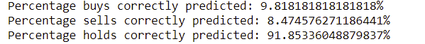
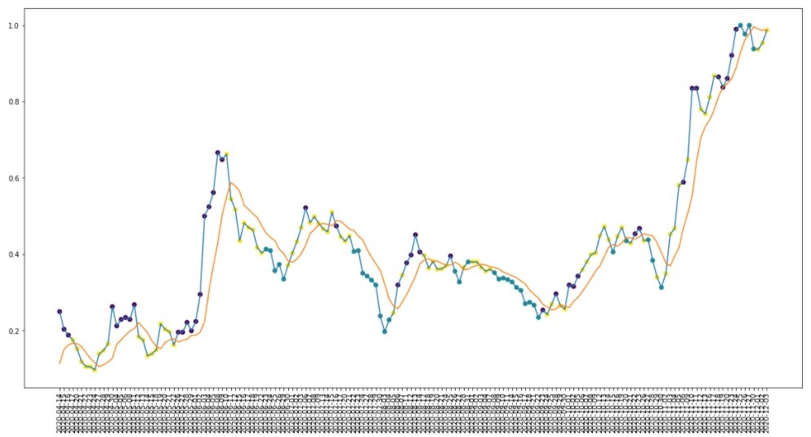
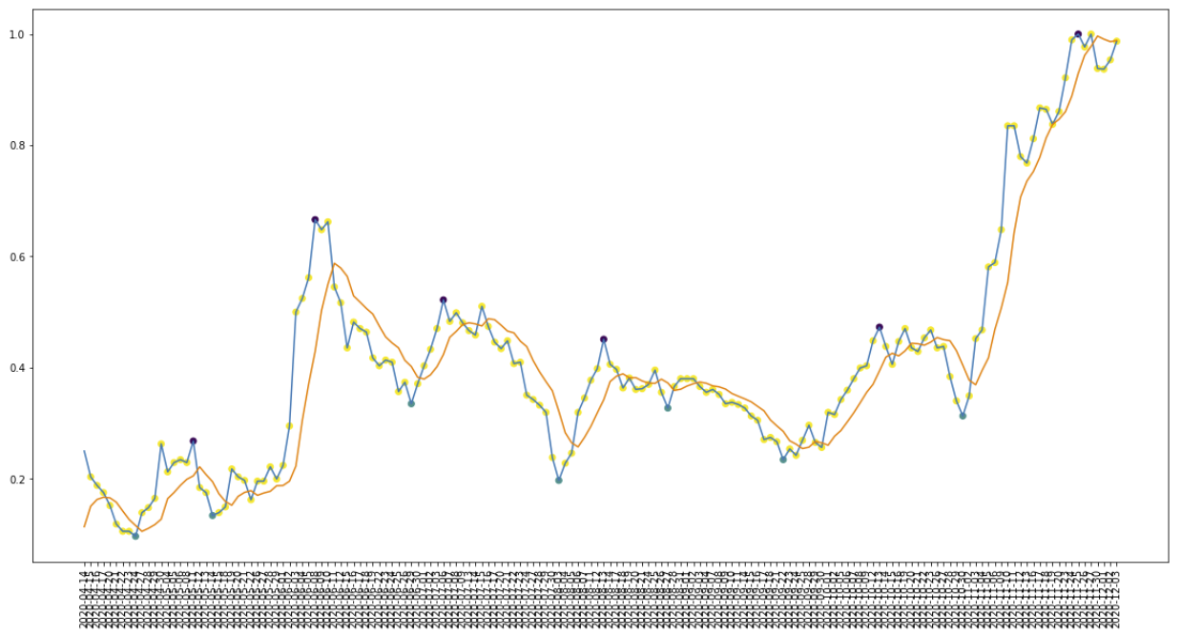
Evaluation Metrics
Actual class labels
Predicted class labels by trained model
Notes:
The reason for producing additional evaluation metrics to evaluate the performance of the models, is because the validation accuracy and loss of the models do not tell the full story of the performance of these models
From the graph above, which shows the prediction results for one of the trained Deep Learning model, with the purple points as predicted “sell” labels, the blue points as predicted “buy” labels and yellow points as predicted “hold” labels. We can observe that the predicted purple “sell” points are generally located at the high points of the graph and the predicted blue “buy” points are generally located at the low points of the graph. Which tells us that the trained model was able to learn to predict stock selling points at high prices and stock buying points at low prices
However, (click) when we look at the validation loss and accuracy of the model, we realised that the validation accuracy of the model is very low, at only 49.7%, this is coupled with the fact that the accuracy of correctly predicted “buy” and “sell” labels are very low as well.
The reason behind this phenomenon is that the actual “buy” and “sell” labels of both the training and validation datasets are the exact peaks and though in the stock prices(click). Judging the models on based on their prediction accuracy for the prediction of “buy” and “sell” labels, will be the equivalent of judging the models’ ability to exactly predict and pinpoint the exact peaks and though points for the stock prices, a task in which even the best human Stock Traders will find it extremely difficult to do so.

Slide 22
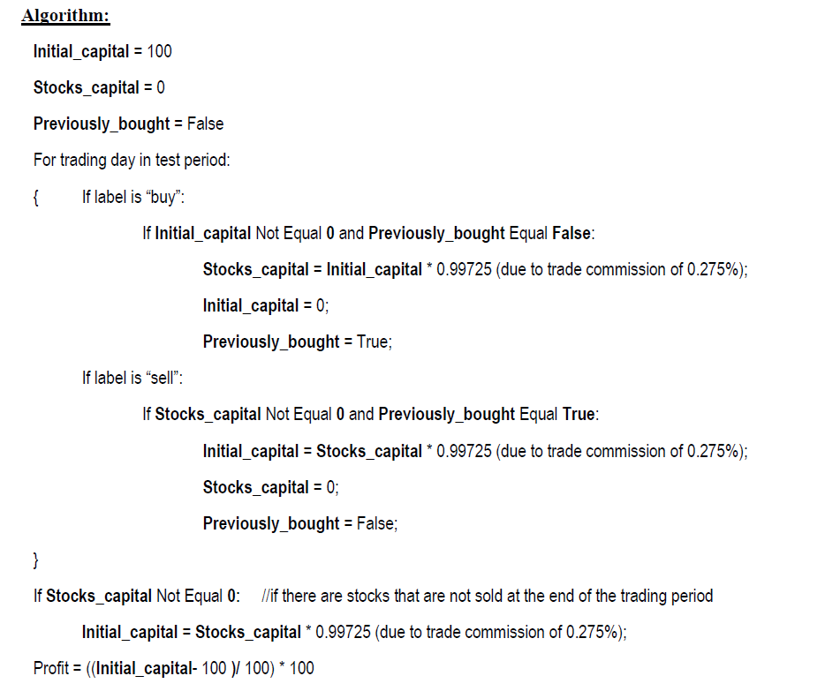
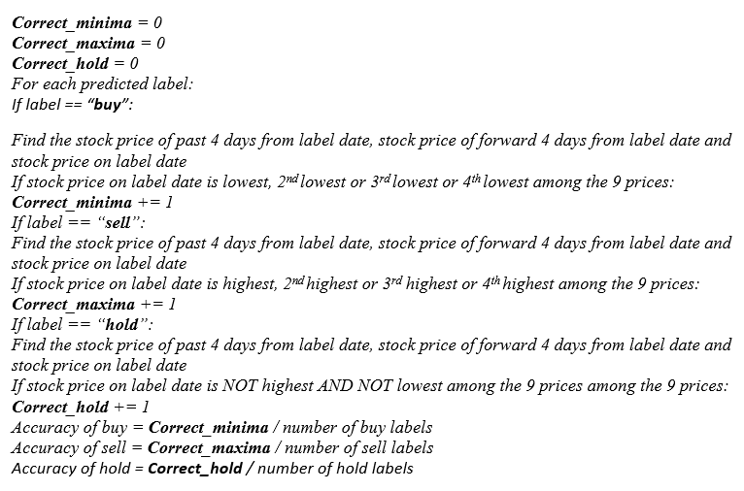



Evaluation Metrics
Notes:
Therefore, we created two algorithms to better evaluate the Deep Learning models
The first algorithm(click) evaluates if a predicted “sell” label is at a high price point, predicted “buy” label is at a low price point, and predicted “hold” label is at a neutral price point within a 9-day stock price window, to allow us to assess whether a trained model has learnt to sell a stock at high price points and buy a stock at low price points.
The second algorithm (click) evaluates how profitable the model will be if we performed stock trades with the predicted labels, taking into consideration stock trading fees.

Slide 23

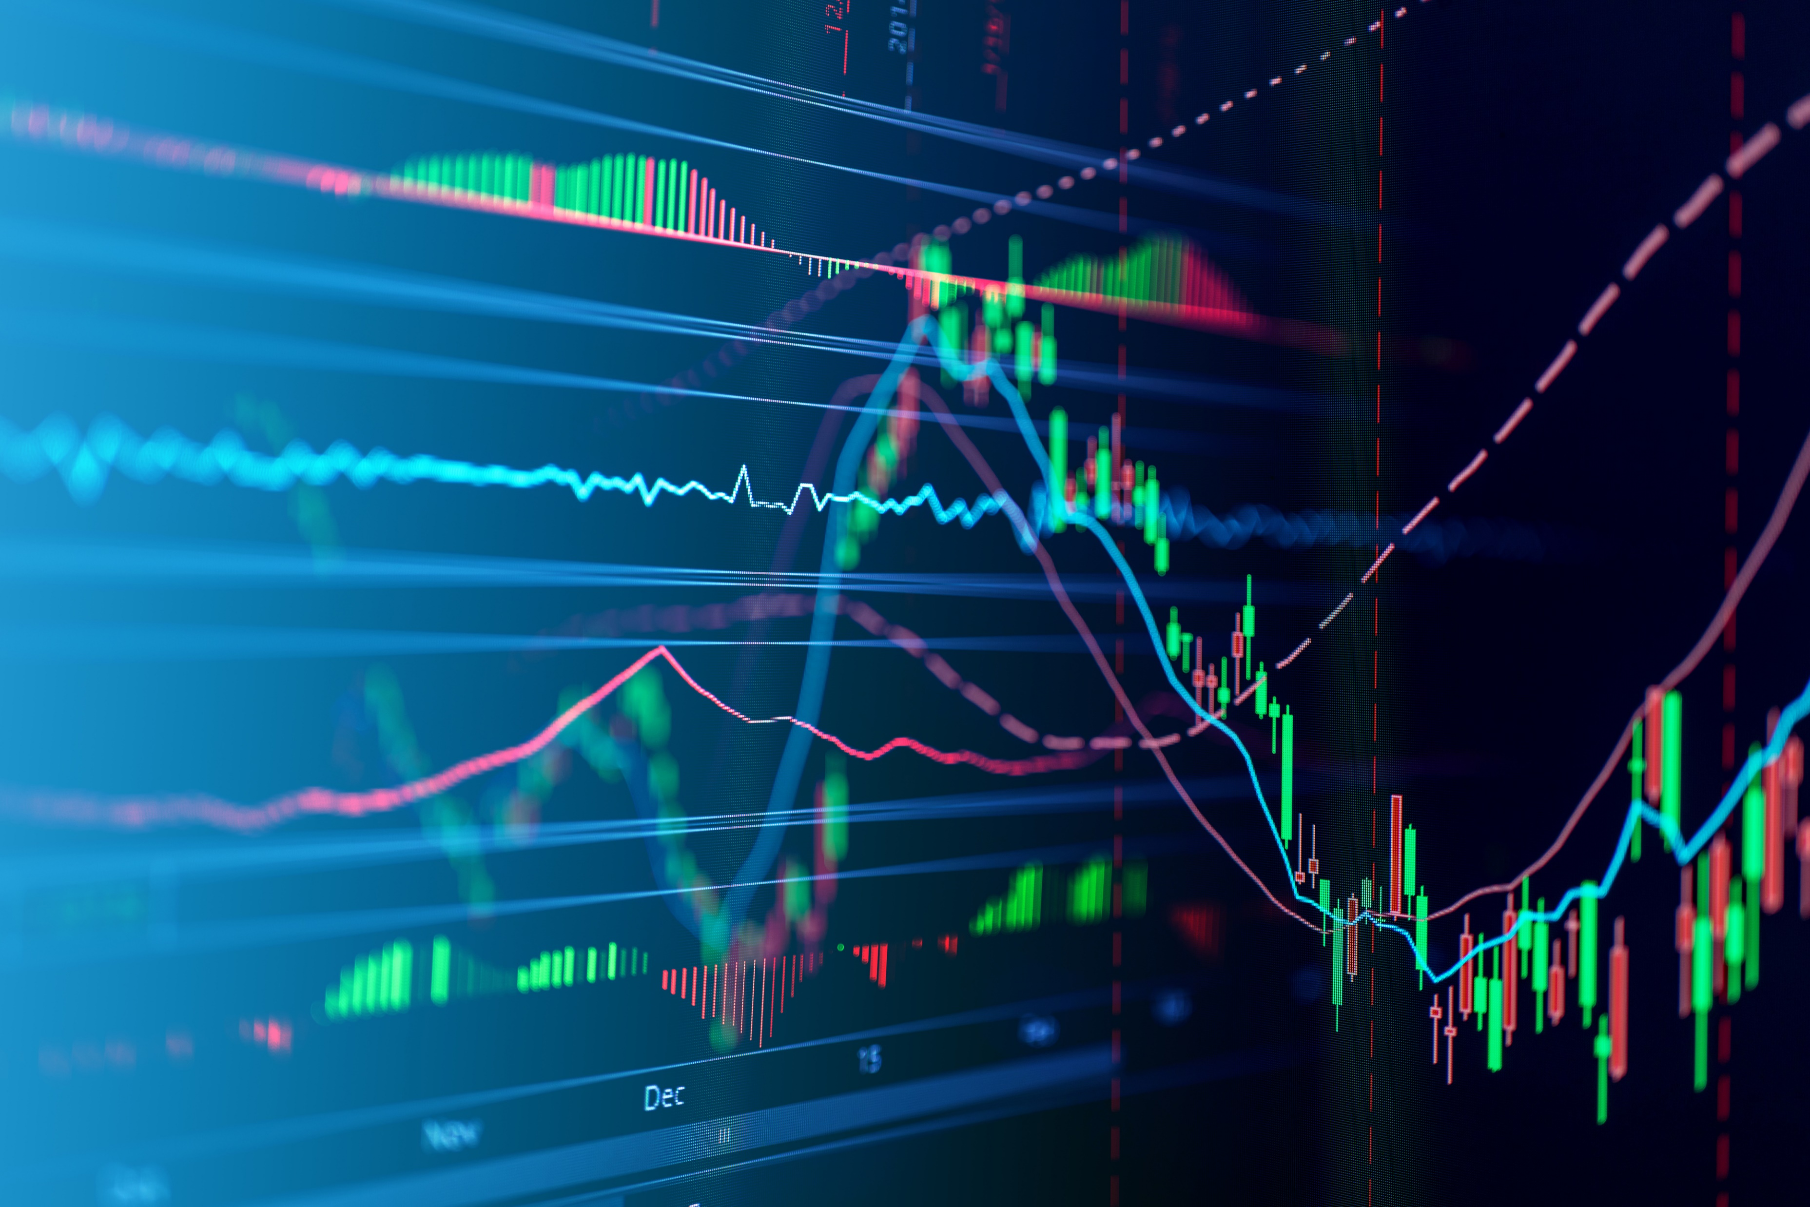

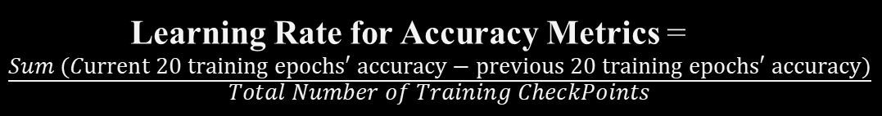
Evaluation Metrics
Evaluate Every 20 Epochs Until 200 Epochs
Learning Rate for Accuracy Metrics = $\frac{\text{Sum}\text{ (}\text{C}\text{urrent}\text{ 20 }\text{training} \text{epochs}\text{′ }\text{accuracy}\text{ − }\text{previous}\text{ 20 }\text{training} \text{epochs}\text{′ }\text{accuracy}\text{)}}{\text{Total} \text{Number} \text{of} \text{Training} \text{CheckPoints}}$
Notes:
As mentioned, the objective of the Project is to investigate the effects of introducing different variations to the training data used to train Deep Learning models(CNN and LSTM models), towards the ability of these models to learn the task of stock trading action prediction.
Therefore, there is a need to evaluate the Deep Learning models while they are being trained (click), in order to observe the effects of the variations introduced to the training data on the learning of these models. Therefore, for all the experiments conducted, we will evaluate the Deep Learning models on the test datasets after every 20 epochs, up until they are trained for 200 epochs. By evaluating the Deep Learning Models after every 20 epochs of training, we provide stopping points along the training of the models, which allows us to record the learning of the Deep Learning Models with each passing epoch.
Also, in order to track the learning of the Deep Learning models during training, we also recorded the Learning Rates of the accuracy of correctly predicting “buy” and “sell” labels, the accuracy of predicting “buy” labels at low price points, as well as the accuracy of predicting “sell” labels at high price points. The Learning Rate of the various accuracy metrics (click) is given as the sum of the percentage increase of the current 20 training epochs’ accuracy from the previous 20 training epochs’ accuracy, for every 20 epochs stopping point and divided by the total number of stopping points for the training of the model.

Slide 24

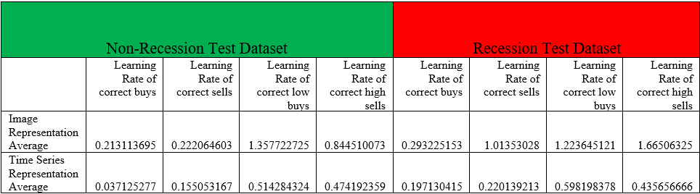
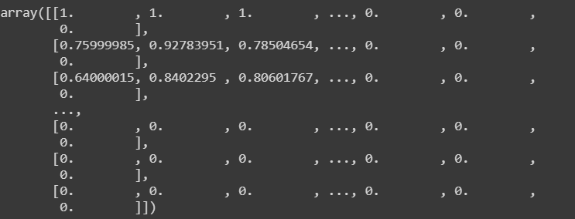
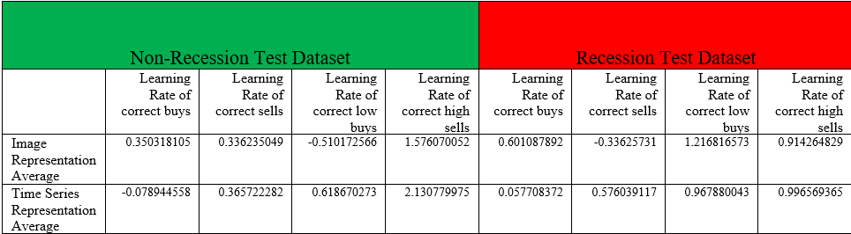
Experiment Results
Variation 1
CNN Models Summary Results
01
CNN Models Trained Using Image Representation Overcome The Difficulty Of Learning Better
LSTM Models Trained Using Time-series Representation Overcome The Difficulty Of Learning Better
Varying The Dimensionality And Presentation Of Training Data
Image Representation
LSTM Models Summary Results
Time-Series Array Representation
Notes:
For the Variation 1 Experiments, we varied the dimensionality and presentation of the training data to the two Deep Learning models, in order to observe if the two Deep Learning models can better overcome the difficulty of learning the task of stock trading action prediction for one form of data input, when compared to another.
From the summary results (click), based on the Learning Rate of the accuracy of predicting “buy” labels at low price points, as well as the accuracy of predicting “sell” labels at high price points
We were able to conclude(click) that CNN models trained using training data presented in the form of image representation, can overcome the difficulty of learning better than that of CNN models trained using training data presented in the form of time-series representation, for the task of stock trading action prediction. This proves our hypothesis that CNN models, which emulates the visual cortex of the human brain, can overcome the difficulty of learning better when trained with data in the form of images, as compared to when trained with data in the form of time-series arrays, for the task of stock trading action prediction.
We were also able to conclude that LSTM models trained using training data presented in the form of time-series representation, can overcome the difficulty of learning better than that of LSTM models trained using training data presented in the form of image representation, for the task of stock trading action prediction which proves that LSTM models, which emulates the Long Short-Term Memory of the human brain, can overcome the difficulty of learning better when trained with sequential data in the form of time-series arrays, as compared to when trained with data in the form of image representation, for the task of stock trading action prediction.

Slide 25
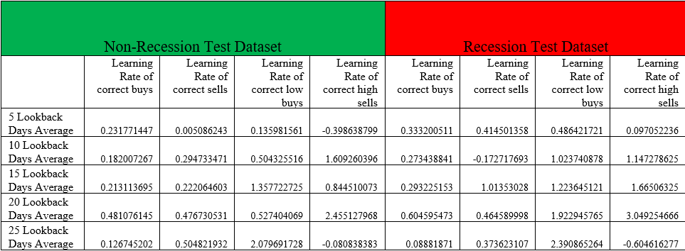
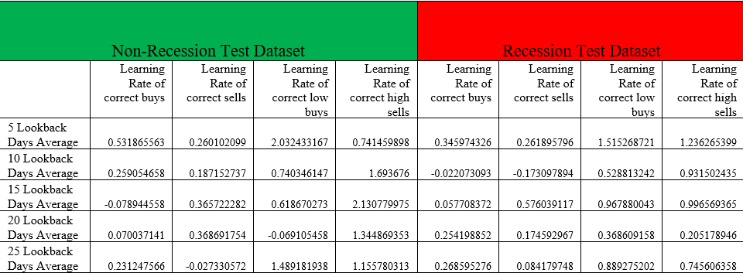
Experiment Results
15 Days Lookback Period
CNN Models Trained Using 20 Lookback Trading Days Overcome The Difficulty Of Learning Better
LSTM Models Trained Using 5 Lookback Trading Days Overcome The Difficulty Of Learning Better
Number Of Days Used As The Lookback Period For Training Samples Does Affect Learning Ability Of Models
Variation 2
02
Varying Number Of Past Trading Days Used As Lookback Period For Training Samples
10 Days Lookback Period
CNN Models Summary Results
20 Days Lookback Period
LSTM Models Summary Results
Notes:
For the Variation 2 Experiments, we varied the number of past trading days to be used as the lookback period for the training samples of the 4 technical indicators data features, used to train the Deep Learning models in order to investigate how the number of time-steps, or lookback period, for time-series data, affects the ability of Deep Learning models to identify stock trading cycles in the input data sequences and make accurate stock trading action predictions from them.
From the summary results (click), based on the Learning Rate of the accuracy of predicting “buy” labels at low price points, as well as the accuracy of predicting “sell” labels at high price points
We were able to conclude(click) that CNN models trained on training samples using 20 lookback trading days, can overcome the difficulty of learning better than that of CNN models trained on training samples using other number of lookback trading days and LSTM models trained on training samples using 5 lookback trading days, are able to overcome the difficulty of learning better than that of LSTM models trained on training samples using other number of lookback trading days.
Hence, we can conclude that the number of days used as the lookback period for training samples does affect the models’ ability to identify the cycle and the trend of the stock, for them to accurately make stock trading action predictions. We were also able to observe that the optimal number of trading days used as the lookback period for CNN and LSTM models are different.

Slide 26
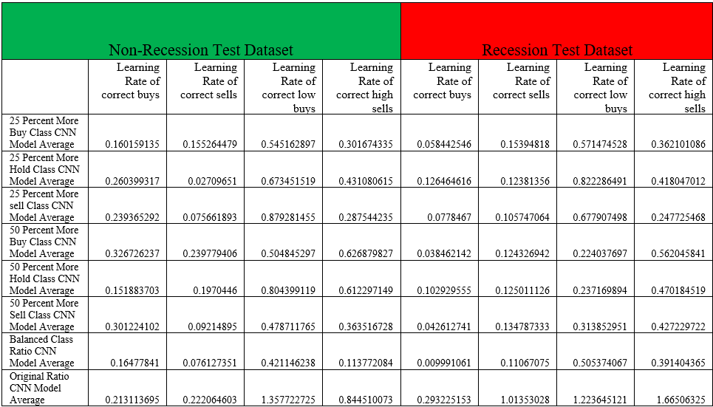
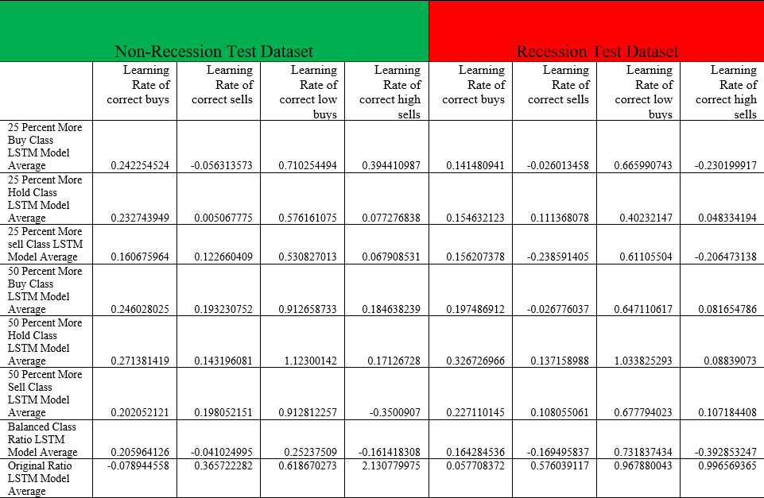
Experiment Results
25 percent more “Buy” Class Samples
25 percent more “Hold” Class Samples
25 percent more “Buy” Class Samples
25 percent more “Sell” Class Samples
Variation 3
03
Variation 3: Training Samples Ratio
CNN Models Summary Results
Varying Ratio Of Training Samples For Each Class
25 percent more “Hold” Class Samples
Disproves Hypothesis That Models Can Achieve Higher Prediction Accuracies For A Particular Class By Increasing Ratio Of Number Of Training Samples For That Class
Disproves Hypothesis That Deep Learning Models Can Predict Each Class With Same Level Of Accuracy If Trained With Equal Number Of Training Samples For Each Class
Best Models Trained Using The Natural Data Distribution
25 percent more “Sell” Class Samples
Variation 3: Training Samples Ratio
LSTM Models Summary Results
Notes:
For the Variation 3 Experiments, we varied the ratio of the number of training samples within the training dataset for each class( “buy” class, “sell” class, “hold class), in order to observe if the ratio of the number of training samples for each class in the training dataset, affects the difficulty in learning of the task of stock trading action prediction for Deep Learning models.
The summary results (click), for both CNN and LSTM models disproves our hypothesis that Deep Learning models can achieve higher prediction accuracies for a particular class, if we were to increase the ratio of the number of training samples for that particular class in the training dataset, used to train the models.
The results also disproves our hypothesis that Deep Learning models are able to predict each class with the same level of accuracy if trained with a training dataset of equal number of training samples for each class. The models that overcome the difficulty of learning the best are the models trained using the natural data distribution for training data.

Slide 27
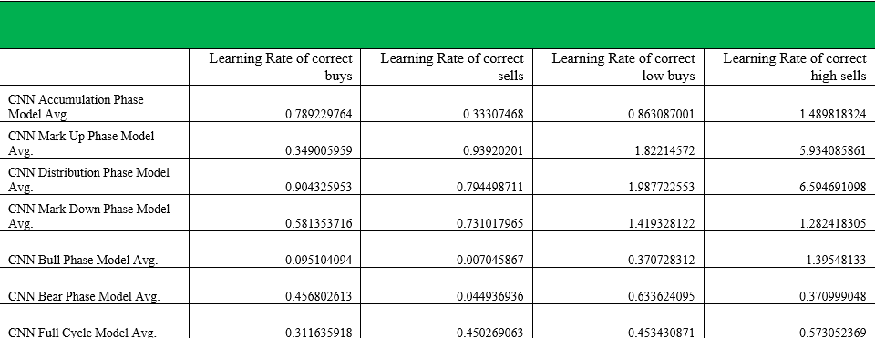
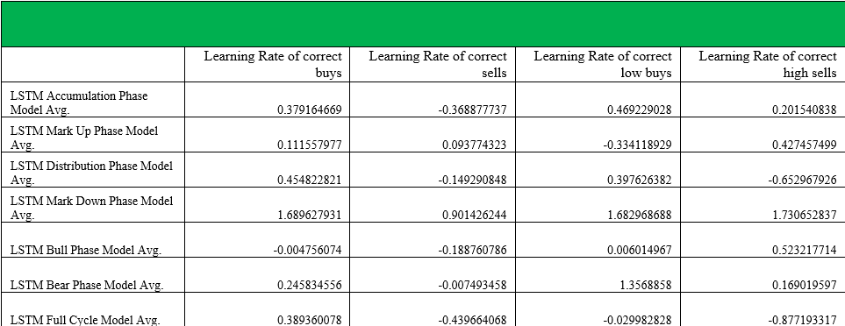
Experiment Results
Variation 4
04
Stock Cycle Phase Used For Training Samples
CNN Models Summary Results
LSTM Models Summary Results
CNN Models Trained With Training Dataset Built Using Only A Particular Stock Cycle Phase
Able To Achieve High Prediction Accuracies For Test Dataset Built Using Data From The Same Stock Cycle Phase
LSTM Models Trained With Training Dataset Built Using Only A Particular Stock Cycle Phase
Not Able To Achieve High Prediction Accuracies For Test Dataset Built Using Data From The Same Stock Cycle Phase
Notes:
For the Variation 4 Experiments, we varied the stock cycle phase in which to extract stock data from, to build the training datasets, to build variant training dataset with stock data extracted only from a particular phase of the stock cycle in order to observe if a model trained with a training dataset built using only one particular stock cycle phase can achieve high prediction accuracies for making predictions on the test dataset built using data only from the same stock cycle phase.
From the summary results (click), we discovered that for CNN models, models trained with a training dataset built using only one particular stock cycle phase, are generally able to achieve high prediction accuracies for making predictions on the test dataset built using data only from the same stock cycle phase.
In contrast (click), for LSTM models, models trained with a training dataset built using only one particular stock cycle phase, are generally not able to achieve high prediction accuracies for making predictions on the test dataset built using data only from the same stock cycle phase.

Slide 28
Experiment Results
Variation 5
05
Inclusion Of Stock Price Data Of Another Stock From The Same Business Sector
To Observe If Inclusion Of Stock Price Data Of Market Leader Stock In Same Business Sector Aid In Overcoming The Difficulty Of Learning
CNN Models Trained With Supporting Price Data Perform Better
LSTM Models Trained WITHOUT Supporting Price Data Perform Better
Inclusion of Supporting Price Data to Training Samples
Notes:
For the Variation 5 Experiments, we introduced to the training data used to train the Deep Learning models the inclusion of the stock price data of another stock from the same business sector, in addition to the data of the original four technical indicators of the particular stock being used to train the Deep Learning models.
In order to observe if the inclusion of stock price data of the market leader stock in the same business sector, to the training data of the stock we are using to train the Deep Learning models, will aid the Deep Learning models in terms of the difficulty of learning the task of stock trading action prediction.
From the results(click), we are able to observe that for CNN models trained with training datasets supplemented with supporting price data of a large market capitalization stock from the same business sector, perform better than the models trained with training datasets without supporting price data added to them.
In contrast, for LSTM models trained with training datasets without supporting price data added to them, perform better than the models trained with training datasets supplemented with supporting price data of a large market capitalization stock from the same business sector.

Slide 29
Experiment Results
Variation 6
06
Varying Category Of Market Capitalization Of Stocks Used To Build Training Datasets
Vary The Category Of The Market Capitalization Of The Stocks
Observe If The Market Capitalization Of Stocks Used Affect Models’ Ability To Learn
Both CNN And LSTM Models Trained With Training Datasets Built Using Large Market Capitalization Stocks Perform Better
Notes:
For the Variation 6 Experiments, we varied the category of the Market Capitalization of the stocks used to build the training datasets for training the Deep Learning models, in order to observe if the type of Market Capitalization of the underlying stocks used for the building the training datasets affect models’ ability to learn the stock trading action prediction task.
From the results obtained(click), we observed that for both CNN and LSTM models, the models trained with training datasets built using the stock data of large market capitalization stocks, perform better than the models trained with training datasets built using the stock data of small market capitalization and medium market capitalization stocks.

Slide 30
04
Conclusion

Slide 31
Conclusions
Data Representation Affects Ability Of Deep Learning Models To Learn
Data Variation Affects Ability Of Deep Learning Models To Learn
CNN And LSTM Models Are Affected By Variations In Training Data Differently
Certain Variations Beneficial Towards Ability Of Deep Learning Models To Learn
Notes:
From the various experiments conducted to observe the effects of introducing different variations to the training data used to train Deep Learning models, on the ability of these models to learn the task of stock trading action prediction, we were able to make the following conclusions:
The format(click) in which data is presented to the two different Deep Learning architectures, LSTM and CNN affects their ability to learn the task of stock trading action prediction. Where CNN models trained using training samples presented in the form of image representation and LSTM models trained using training samples presented in the form of time-series representation were able to learn better.
(Click) Variations introduced to training data used to train Deep Learning models does affect their ability to learn the task of stock trading action prediction. Therefore, when we train Deep Learning models for Stock Market prediction tasks, we should take into consideration how various variations may affect the training of the models and what variations can be introduced to improve training.
(Click) CNN and LSTM models are affected by variations introduced to training data differently and from the results obtained from the experiments, some variations introduced to training data of CNN models can aid the models in their ability to learn while most variations introduced to training data of LSTM models does not aid the models in their ability to learn and with some even causing the models to learn poorly.
(Click) Some variations, when introduced to the training data used to train the Deep Leaning models, are beneficial towards helping them better overcome the difficulty of learning the information from the training data during training which enable them to solve the task of stock trading action prediction.

Slide 32
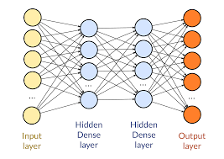



Future Work
Variation 1
Local Model 1
Local Model 3
Variation 3
Date | Close | SMA | … | WILLR
02/01/20 | 30.1 | 29.9 |  | 2.1
03/01/20 | 30.2 | 30.0 |  | 2.3
06/01/20 | 30.0 | 30.1 |  | 1.5
07/01/20 | 31.1 | 31.2 |  | 2.9
Date | Close | SMA | … | WILLR
02/01/20 | 30.1 | 0 |  | 2.1
03/01/20 | 30.2 | 0 |  | 2.3
06/01/20 | 30.0 | 0 |  | 1.5
07/01/20 | 31.1 | 0 |  | 2.9
Global Model
Variation 2
Variation 4
Date | Close | SMA | … | WILLR
02/01/20 | 30.1 | 29.9 |  | 0
03/01/20 | 30.2 | 30.0 |  | 0
06/01/20 | 30.0 | 30.1 |  | 0
07/01/20 | 31.1 | 31.2 |  | 0
Date | Close | SMA | … | Support Stock
02/01/20 | 30.1 | 29.9 |  | 40.2
03/01/20 | 30.2 | 30.0 |  | 40.3
06/01/20 | 30.0 | 30.1 |  | 40.1
07/01/20 | 31.1 | 31.2 |  | 41.2
Local Model 2
Federated Learning System
Local Model 4
Notes:
The results of the study will be of assistance towards future studies conducted on the use of Deep Learning models for stock market prediction tasks, by providing insights on how to improve the training of the models with the use of training data introduced with variations beneficial towards helping the Deep Learning models better overcome the difficulty of learning from the training data during training.
(Click)Using the project findings, future work can be done to build a Federated Learning system
that consists of a network of Deep Learning models, each trained on a set of training data with a specific variation, to enable them to make more accurate predictions on stock data of a specific variation.
The trained local models will be then used to update a centralized global model so that the global model can learn better with the help of the trained local models, improving its weights to be able to make accurate prediction on stock data in general.

Slide 33
THANK YOU!

Slide 34

Q&A

